Slide 1
Amethyst
By Jersey Boys

Slide 2
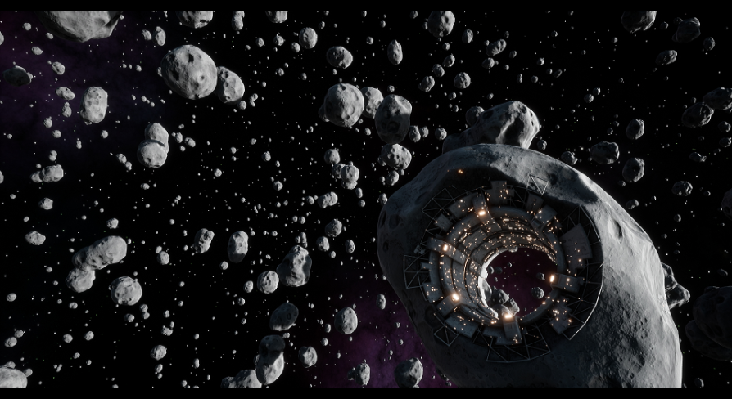
Story
In the Andromeda Galaxy, you are flying back home to Titan. The planet is overrun with some virus from an unknown alien planet. Your spaceship is carrying five gems that have powers that will save Titan. While you are navigating through an asteroid field surrounding Planet 0259-S, your shipcraft is hit. Knowing the importance of the gems, you had to throw gems from the ship to avoid the destruction of them. They are scattered around your crash site. Your goal is simple: collect the gems to save your home planet, but beware what lies on the surface.

Slide 3
Gameplay & Mechanics
There will be 4 levels and a ‘home’ map interconnecting all of them with portals for a total of 5 scenes
The player must solve puzzles and avoid enemies in order to beat each level, after which the portal will close for each level
Upon successful completion of all levels the game will end in a win
There will be 3 lives for each level
Upon losing all lives the level will restart
Player can die from enemies or environmental factors

Slide 4
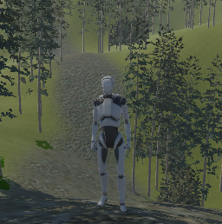
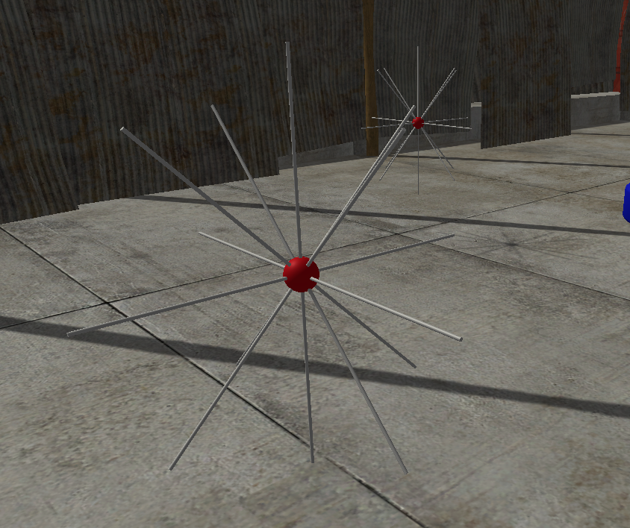
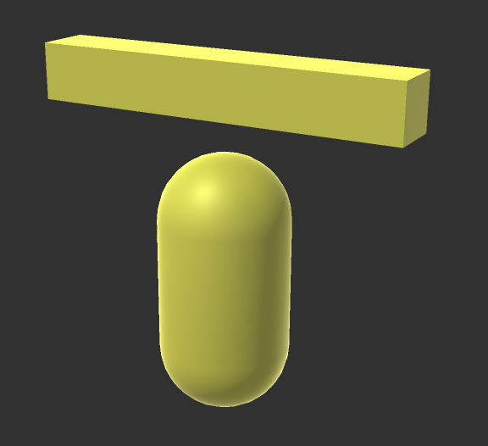
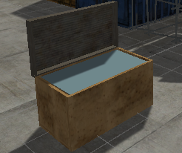
Formal Elements
Enemies
Interactable Environment Features
Player Movement
Collectable Resources
Vehicle Movement
Virus Particles
Player
Guardian
Chest

Slide 5
Work Plan
Create/import assets and resources from asset store that can be useful for any of the scenes
Add interactions for the newly added assets
Create five separate “realms” in the planet where the environment is different
This allows each member of the team to work independently
Add the game play experience and integrate the game logic with all the character and objects in the game

Slide 6
Thank You

